Slide 1
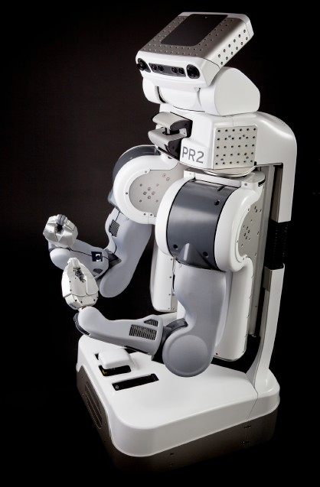
Announcements
Homework 9
  Released soon, due Monday 4/14 at 11:59pm
Final Contest (Optional)
  Opportunities for extra credit every Sunday
Cal Day – Robot Learning Lab Open House
  Saturday 10am-1pm
  3rd floor Sutardja Dai Hall
  Robot demos of towel folding, knot tying, high-fives, fist-pumps, hugs

Slide 2
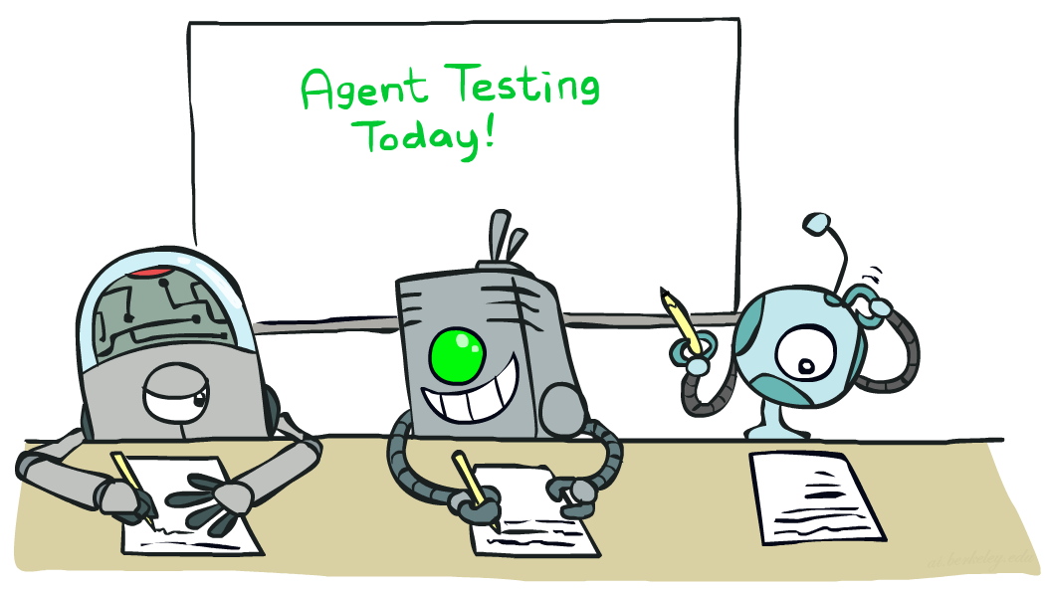

CS 188: Artificial Intelligence
Naïve Bayes
Instructors: Dan Klein and Pieter Abbeel --- University of California, Berkeley
[These slides were created by Dan Klein and Pieter Abbeel for CS188 Intro to AI at UC Berkeley. All CS188 materials are available at http://ai.berkeley.edu.]
Notes:
Please retain proper attribution, including the reference to ai.berkeley.edu. Thanks!

Slide 3
Machine Learning
Up until now: how use a model to make optimal decisions
Machine learning: how to acquire a model from data / experience
  Learning parameters (e.g. probabilities)
  Learning structure (e.g. BN graphs)
  Learning hidden concepts (e.g. clustering)
Today: model-based classification with Naive Bayes

Slide 4
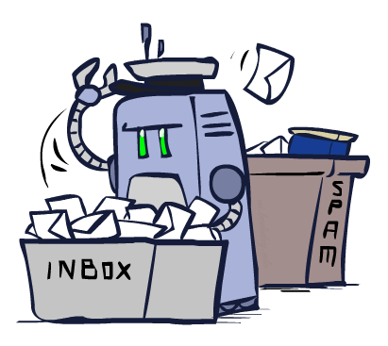
Classification

Slide 5
Example: Spam Filter
Input: an email
Output: spam/ham
Setup:
  Get a large collection of example emails, each labeled “spam” or “ham”
  Note: someone has to hand label all this data!
  Want to learn to predict labels of new, future emails
Features: The attributes used to make the ham / spam decision
  Words: FREE!
  Text Patterns: $dd, CAPS
  Non-text: SenderInContacts
  …
Dear Sir.
First, I must solicit your confidence in this transaction, this is by virture of its nature as being utterly confidencial and top secret. …
TO BE REMOVED FROM FUTURE MAILINGS, SIMPLY REPLY TO THIS MESSAGE AND PUT "REMOVE" IN THE SUBJECT.
99 MILLION EMAIL ADDRESSES
FOR ONLY $99
Ok, Iknow this is blatantly OT but I'm beginning to go insane. Had an old Dell Dimension XPS sitting in the corner and decided to put it to use, I know it was working pre being stuck in the corner, but when I plugged it in, hit the power nothing happened.

Slide 6





Example: Digit Recognition
Input: images / pixel grids
Output: a digit 0-9
Setup:
  Get a large collection of example images, each labeled with a digit
  Note: someone has to hand label all this data!
  Want to learn to predict labels of new, future digit images
Features: The attributes used to make the digit decision
  Pixels: (6,8)=ON
  Shape Patterns: NumComponents, AspectRatio, NumLoops
  …
0
1
2
1
??

Slide 7
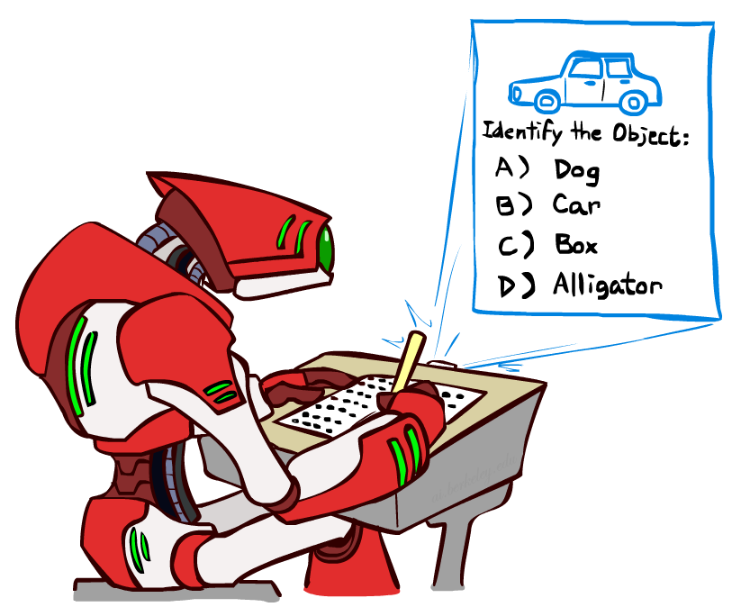
Other Classification Tasks
Classification: given inputs x, predict labels (classes) y
Examples:
  Spam detection (input: document,
classes: spam / ham)
  OCR (input: images, classes: characters)
  Medical diagnosis (input: symptoms,
classes: diseases)
  Automatic essay grading (input: document,
classes: grades)
  Fraud detection (input: account activity,
classes: fraud / no fraud)
  Customer service email routing
  … many more
Classification is an important commercial technology!

Slide 8
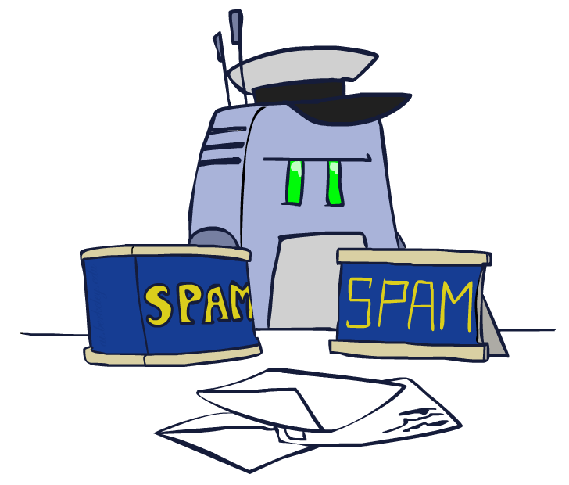
Model-Based Classification

Slide 9
Model-Based Classification
Model-based approach
  Build a model (e.g. Bayes’ net) where both the label and features are random variables
  Instantiate any observed features
  Query for the distribution of the label conditioned on the features
Challenges
  What structure should the BN have?
  How should we learn its parameters?

Slide 10


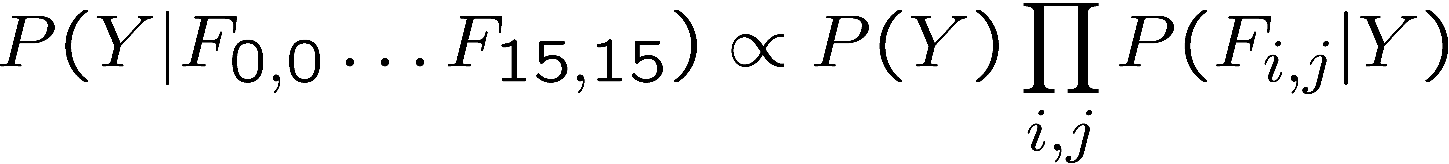
Naïve Bayes for Digits
Naïve Bayes: Assume all features are independent effects of the label
Simple digit recognition version:
  One feature (variable) Fij for each grid position <i,j>
  Feature values are on / off, based on whether intensity
is more or less than 0.5 in underlying image
  Each input maps to a feature vector, e.g.
  Here: lots of features, each is binary valued
Naïve Bayes model:
What do we need to learn?
Y
F1
F2
Fn

Slide 11

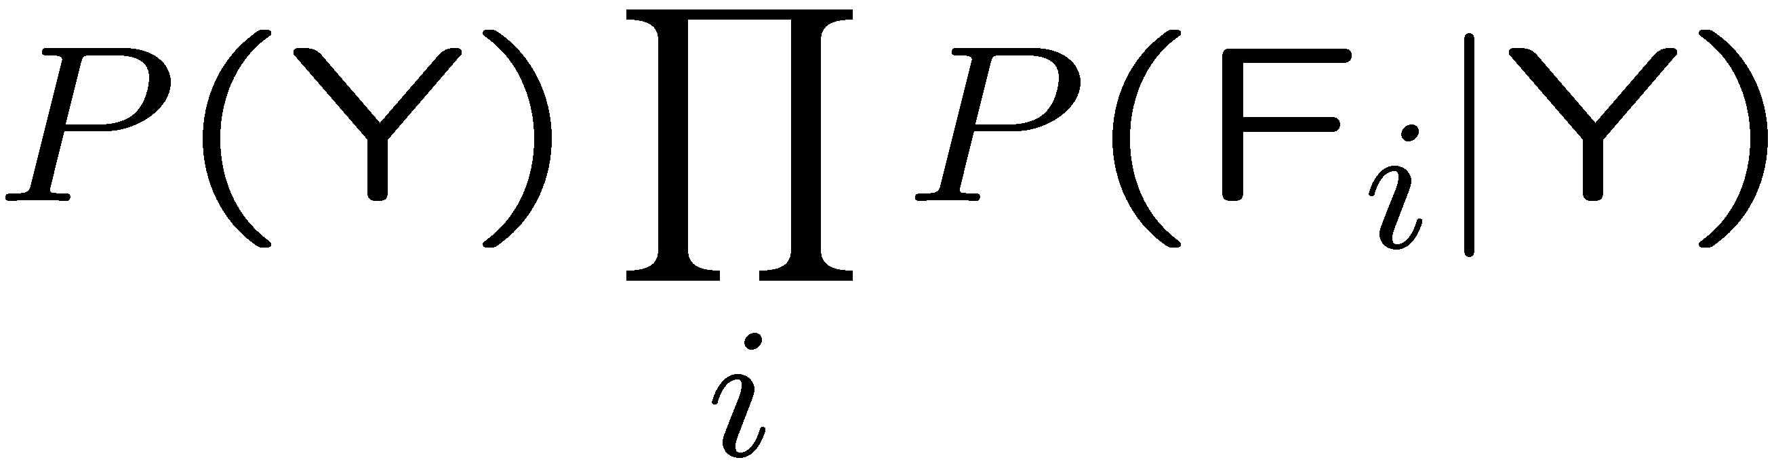
General Naïve Bayes
A general Naive Bayes model:
We only have to specify how each feature depends on the class
Total number of parameters is linear in n
Model is very simplistic, but often works anyway
Y
|Y| parameters
F1
F2
Fn
|Y| x |F|n values
n x |F| x |Y| parameters

Slide 12
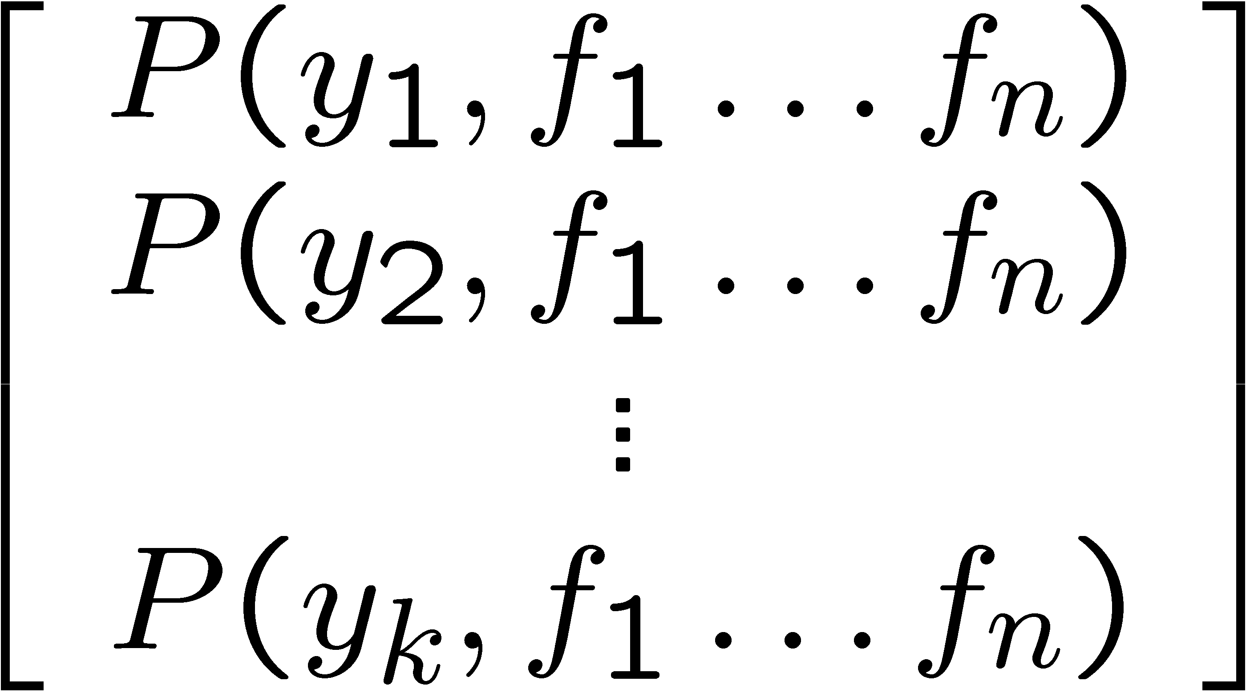
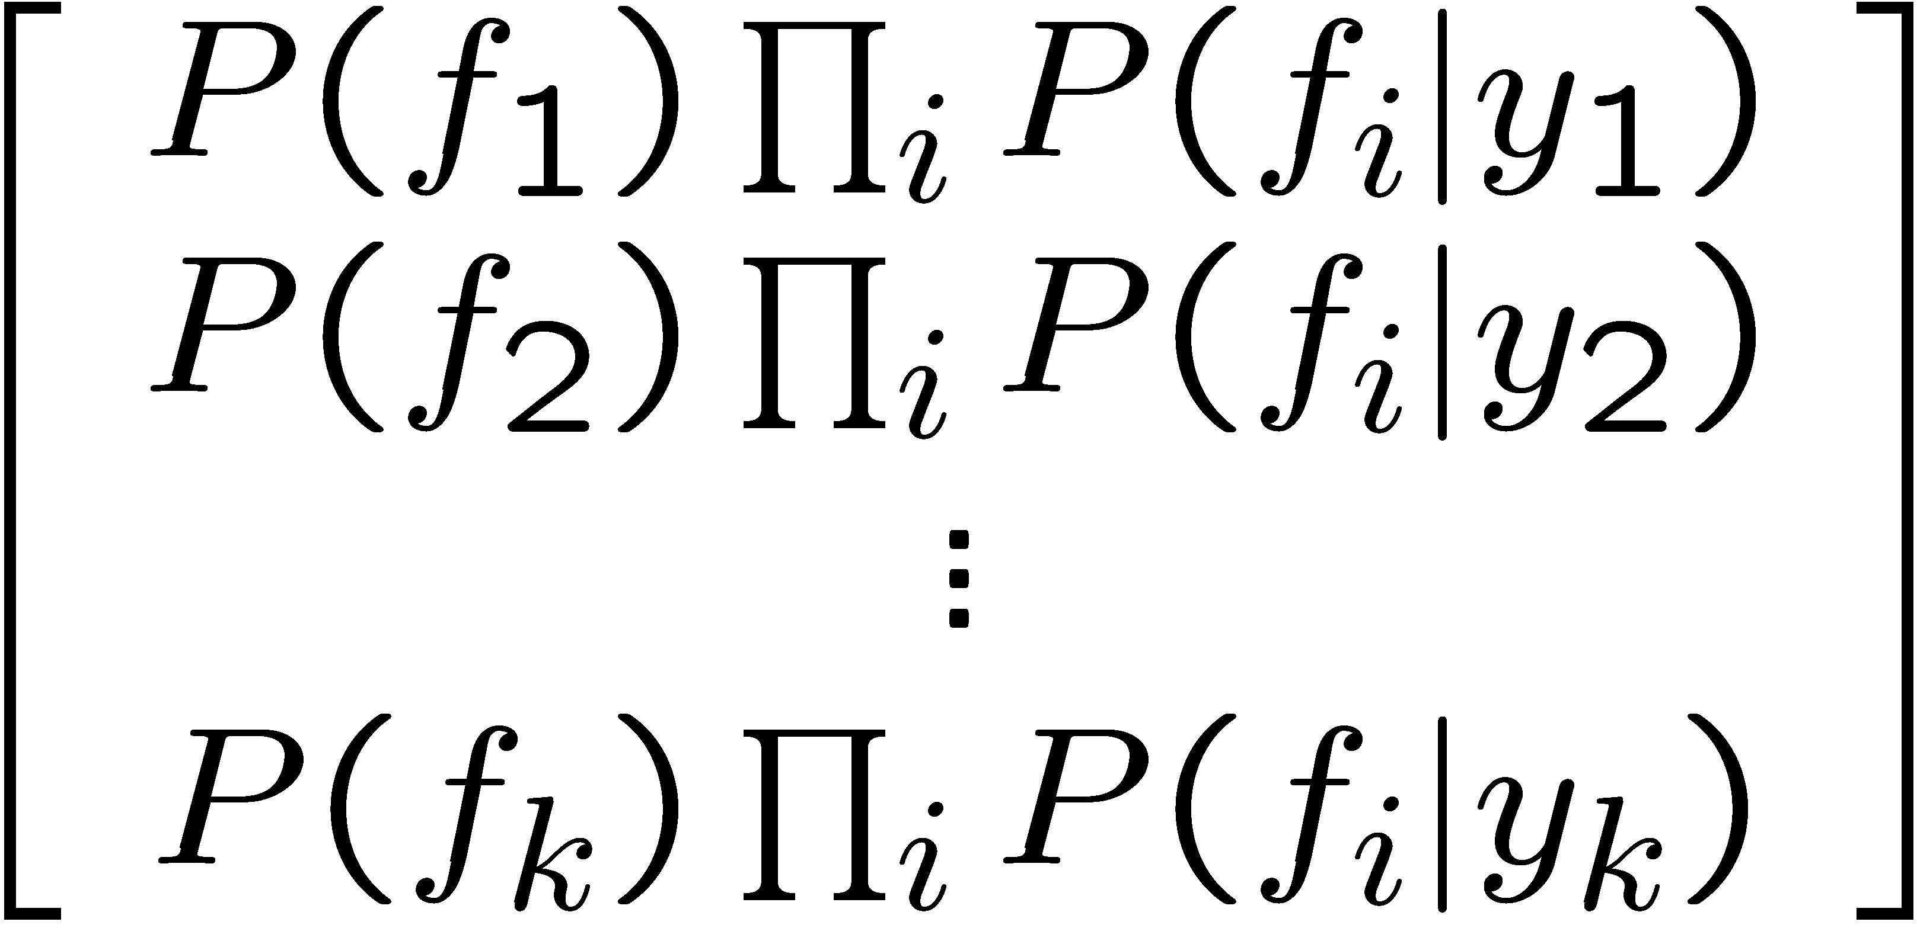

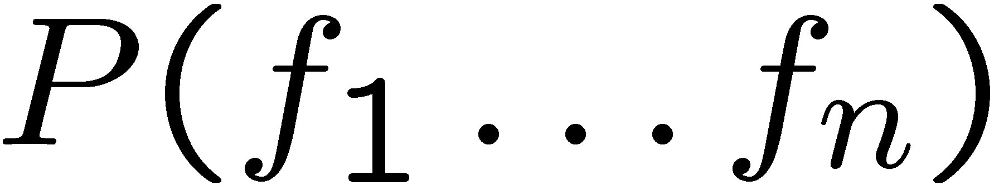
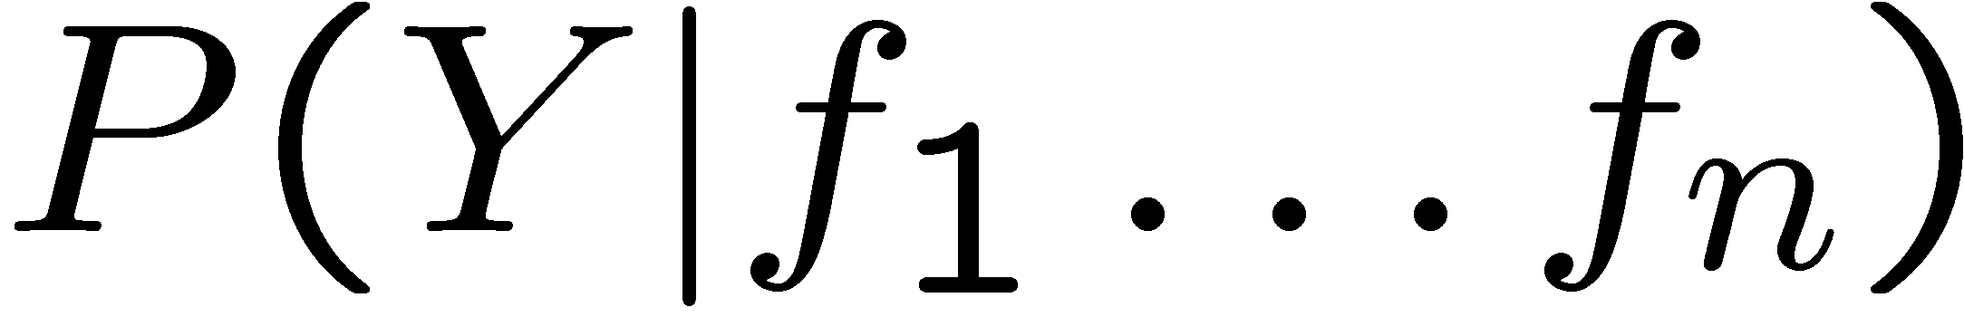
Inference for Naïve Bayes
Goal: compute posterior distribution over label variable Y
  Step 1: get joint probability of label and evidence for each label
  Step 2: sum to get probability of evidence
  Step 3: normalize by dividing Step 1 by Step 2
+

Slide 13
General Naïve Bayes
What do we need in order to use Naïve Bayes?
  Inference method (we just saw this part)
    Start with a bunch of probabilities: P(Y) and the P(Fi|Y) tables
    Use standard inference to compute P(Y|F1…Fn)
    Nothing new here
  Estimates of local conditional probability tables
    P(Y), the prior over labels
    P(Fi|Y) for each feature (evidence variable)
    These probabilities are collectively called the parameters of the model and denoted by θ
    Up until now, we assumed these appeared by magic, but…
    …they typically come from training data counts: we’ll look at this soon

Slide 14
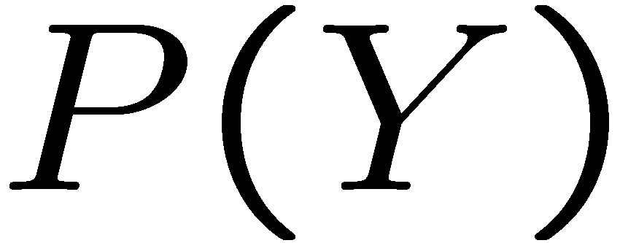


Example: Conditional Probabilities
1 | 0.1
2 | 0.1
3 | 0.1
4 | 0.1
5 | 0.1
6 | 0.1
7 | 0.1
8 | 0.1
9 | 0.1
0 | 0.1
1 | 0.01
2 | 0.05
3 | 0.05
4 | 0.30
5 | 0.80
6 | 0.90
7 | 0.05
8 | 0.60
9 | 0.50
0 | 0.80
1 | 0.05
2 | 0.01
3 | 0.90
4 | 0.80
5 | 0.90
6 | 0.90
7 | 0.25
8 | 0.85
9 | 0.60
0 | 0.80

Slide 15
A Spam Filter
Naïve Bayes spam filter
Data:
  Collection of emails, labeled spam or ham
  Note: someone has to hand label all this data!
  Split into training, held-out, test sets
Classifiers
  Learn on the training set
  (Tune it on a held-out set)
  Test it on new emails
Dear Sir.
First, I must solicit your confidence in this transaction, this is by virture of its nature as being utterly confidencial and top secret. …
TO BE REMOVED FROM FUTURE MAILINGS, SIMPLY REPLY TO THIS MESSAGE AND PUT "REMOVE" IN THE SUBJECT.
99 MILLION EMAIL ADDRESSES
FOR ONLY $99
Ok, Iknow this is blatantly OT but I'm beginning to go insane. Had an old Dell Dimension XPS sitting in the corner and decided to put it to use, I know it was working pre being stuck in the corner, but when I plugged it in, hit the power nothing happened.

Slide 16
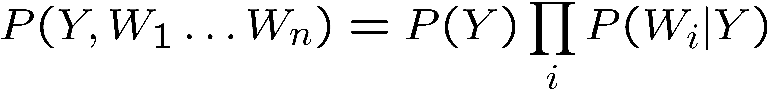
Naïve Bayes for Text
Bag-of-words Naïve Bayes:
  Features: Wi is the word at positon i
  As before: predict label conditioned on feature variables (spam vs. ham)
  As before: assume features are conditionally independent given label
  New: each Wi is identically distributed
Generative model:
“Tied” distributions and bag-of-words
  Usually, each variable gets its own conditional probability distribution P(F|Y)
  In a bag-of-words model
    Each position is identically distributed
    All positions share the same conditional probs P(W|Y)
    Why make this assumption?
  Called “bag-of-words” because model is insensitive to word order or reordering
Word at position i, not ith word in the dictionary!

Slide 17

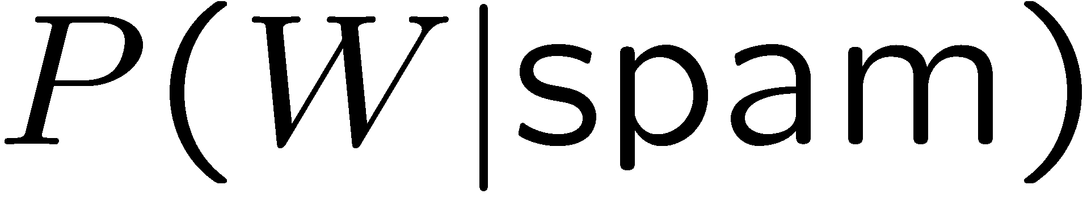
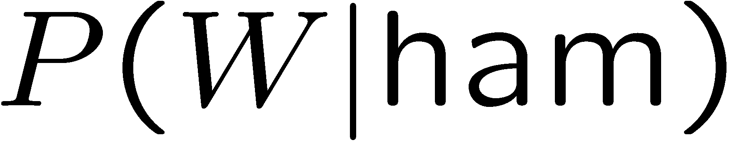
Example: Spam Filtering
Model:
What are the parameters?
Where do these tables come from?
ham : 0.66
spam: 0.33
the : 0.0156
to : 0.0153
and : 0.0115
of : 0.0095
you : 0.0093
a : 0.0086
with: 0.0080
from: 0.0075
...
the : 0.0210
to : 0.0133
of : 0.0119
2002: 0.0110
with: 0.0108
from: 0.0107
and : 0.0105
a : 0.0100
...

Slide 18
Spam Example
Word | P(w|spam) | P(w|ham) | Tot Spam | Tot Ham
(prior) | 0.33333 | 0.66666 | -1.1 | -0.4
Gary | 0.00002 | 0.00021 | -11.8 | -8.9
would | 0.00069 | 0.00084 | -19.1 | -16.0
you | 0.00881 | 0.00304 | -23.8 | -21.8
like | 0.00086 | 0.00083 | -30.9 | -28.9
to | 0.01517 | 0.01339 | -35.1 | -33.2
lose | 0.00008 | 0.00002 | -44.5 | -44.0
weight | 0.00016 | 0.00002 | -53.3 | -55.0
while | 0.00027 | 0.00027 | -61.5 | -63.2
you | 0.00881 | 0.00304 | -66.2 | -69.0
sleep | 0.00006 | 0.00001 | -76.0 | -80.5
P(spam | w) = 98.9

Slide 19
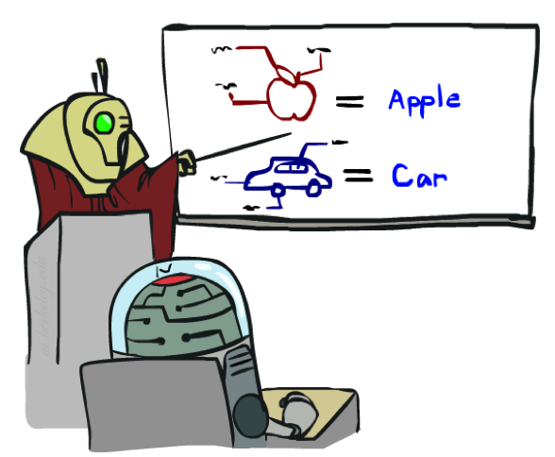
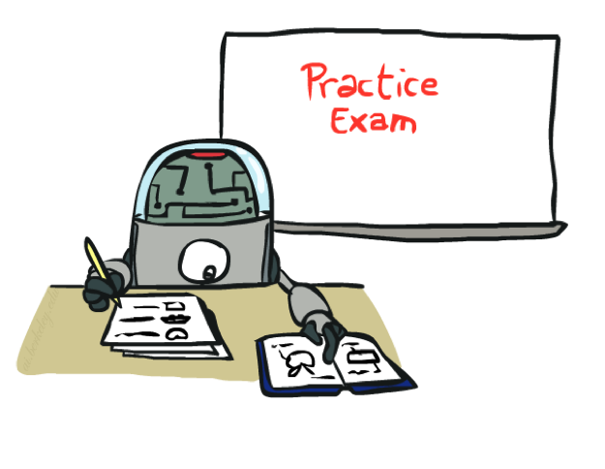
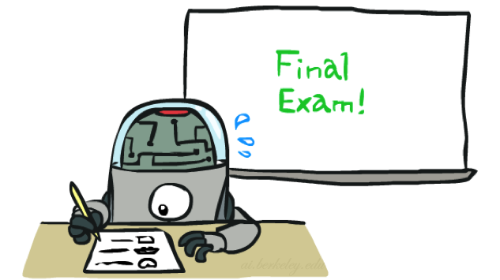
Training and Testing

Slide 20

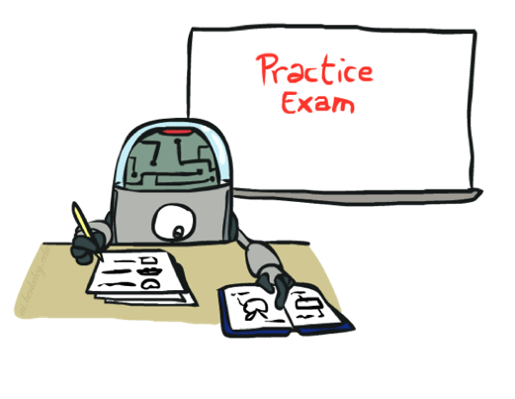
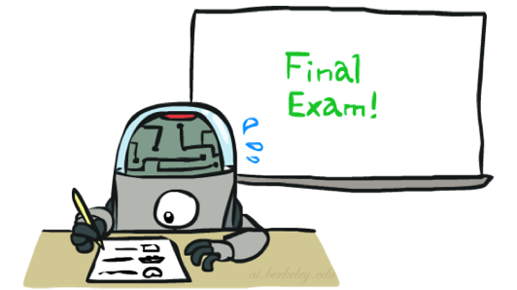
Important Concepts
Data: labeled instances, e.g. emails marked spam/ham
  Training set
  Held out set
  Test set
Features: attribute-value pairs which characterize each x
Experimentation cycle
  Learn parameters (e.g. model probabilities) on training set
  (Tune hyperparameters on held-out set)
  Compute accuracy of test set
  Very important: never “peek” at the test set!
Evaluation
  Accuracy: fraction of instances predicted correctly
Overfitting and generalization
  Want a classifier which does well on test data
  Overfitting: fitting the training data very closely, but not generalizing well
  We’ll investigate overfitting and generalization formally in a few lectures
Training
Data
Held-Out
Data
Test
Data

Slide 21

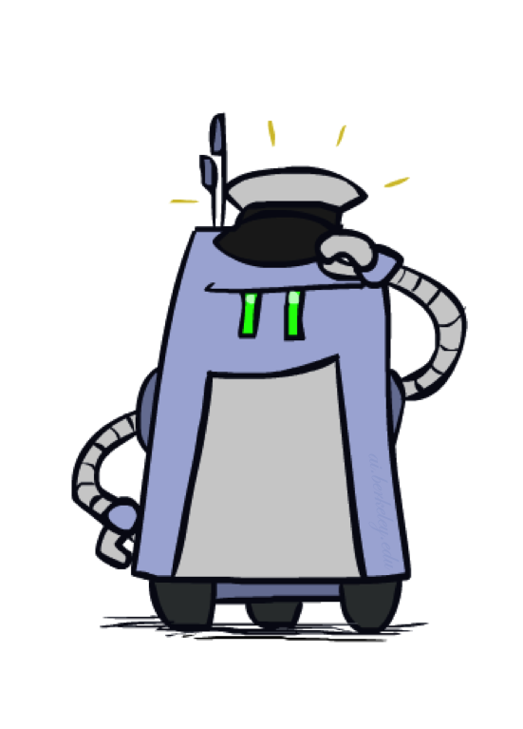
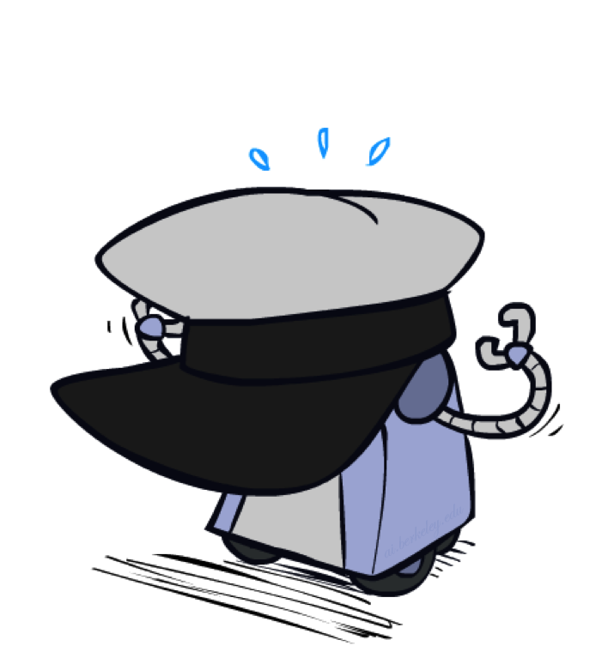
Generalization and Overfitting

Slide 22
Overfitting
30
25
20
Degree 15 polynomial
15
10
5
0
-5
-10
-15
0
2
4
6
8
10
12
14
16
18
20

Slide 23












Example: Overfitting
2 wins!!

Slide 24
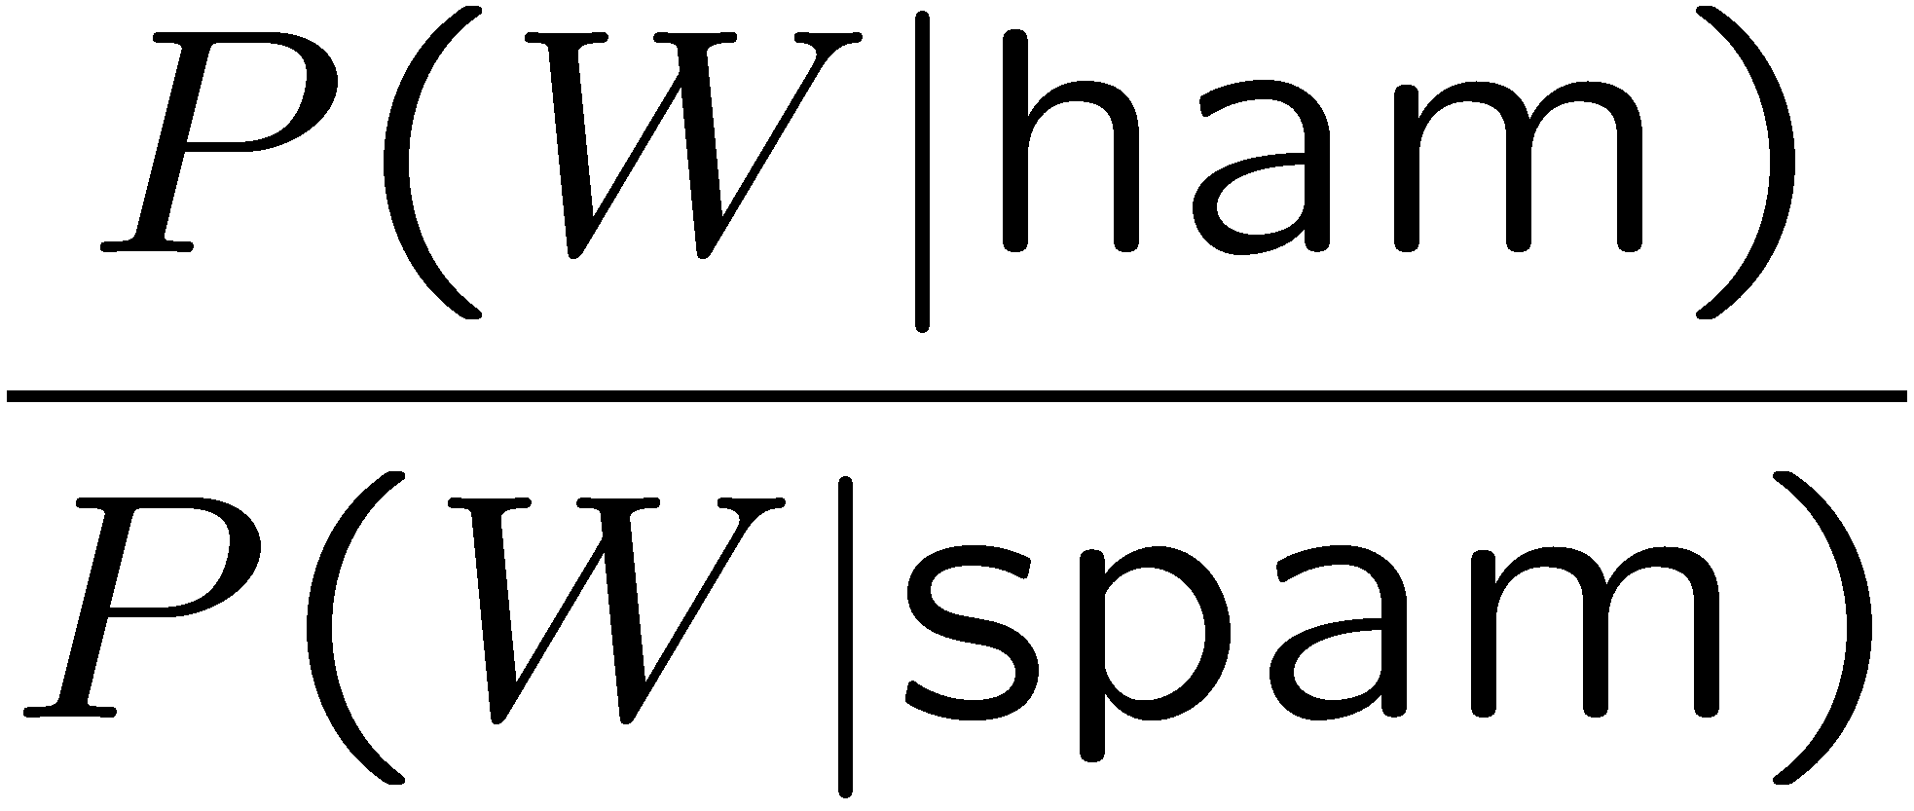
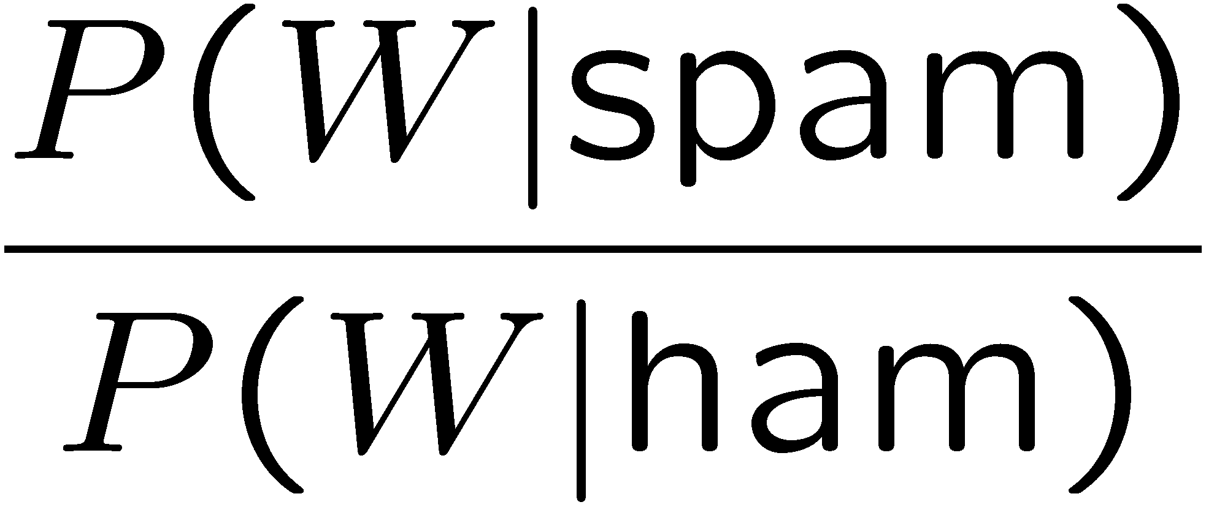
Example: Overfitting
Posteriors determined by relative probabilities (odds ratios):
south-west : inf
nation : inf
morally : inf
nicely : inf
extent : inf
seriously : inf
...
screens : inf
minute : inf
guaranteed : inf
$205.00 : inf
delivery : inf
signature : inf
...
What went wrong here?

Slide 25
Generalization and Overfitting
Relative frequency parameters will overfit the training data!
  Just because we never saw a 3 with pixel (15,15) on during training doesn’t mean we won’t see it at test time
  Unlikely that every occurrence of “minute” is 100% spam
  Unlikely that every occurrence of “seriously” is 100% ham
  What about all the words that don’t occur in the training set at all?
  In general, we can’t go around giving unseen events zero probability
As an extreme case, imagine using the entire email as the only feature
  Would get the training data perfect (if deterministic labeling)
  Wouldn’t generalize at all
  Just making the bag-of-words assumption gives us some generalization, but isn’t enough
To generalize better: we need to smooth or regularize the estimates

Slide 26
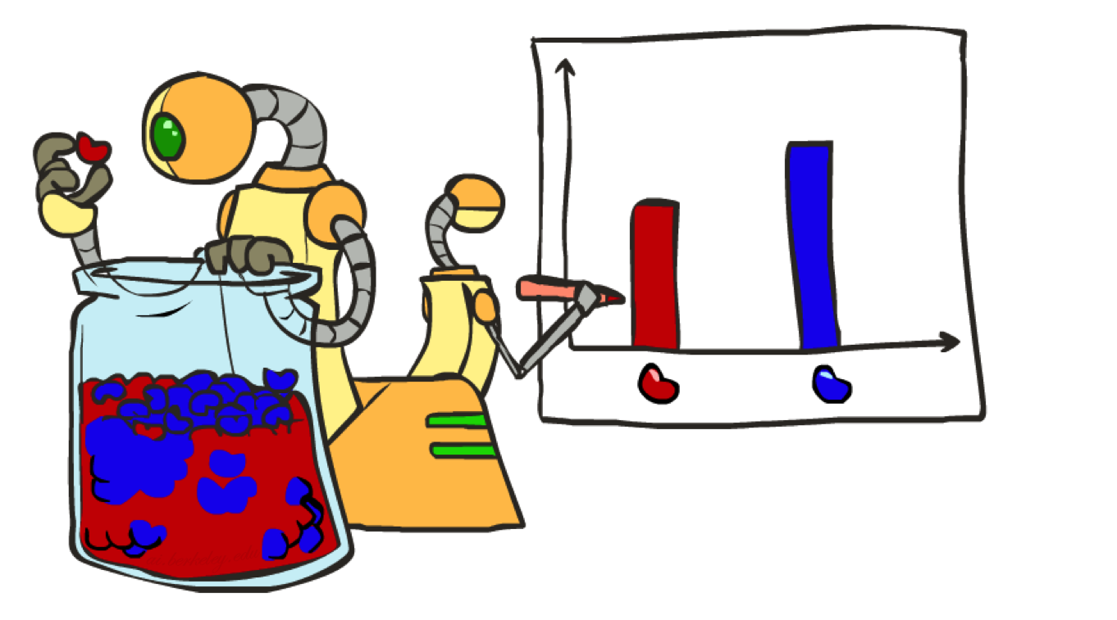
Parameter Estimation

Slide 27
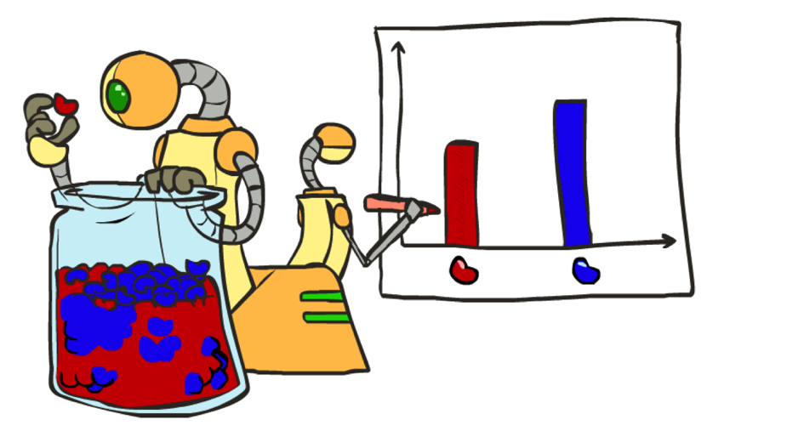
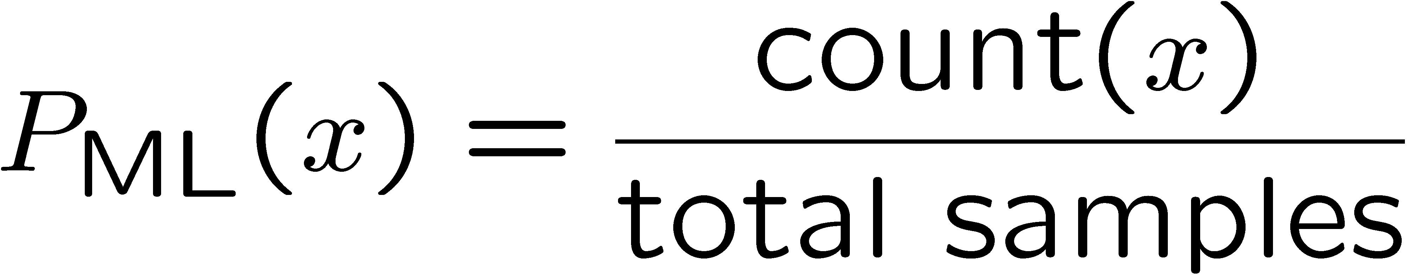

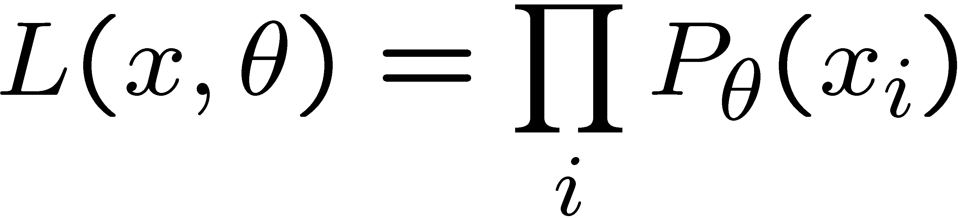
Parameter Estimation
Estimating the distribution of a random variable
Elicitation: ask a human (why is this hard?)
Empirically: use training data (learning!)
  E.g.: for each outcome x, look at the empirical rate of that value:
  This is the estimate that maximizes the likelihood of the data
r
b
b
b
r
r
b
b
b
r
r
b
b
b
b
r
r
b

Slide 28
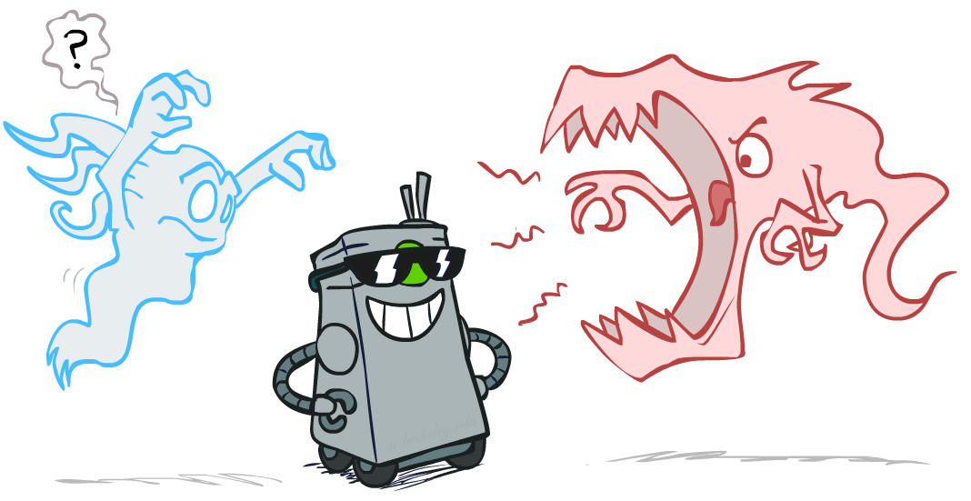
Smoothing

Slide 29
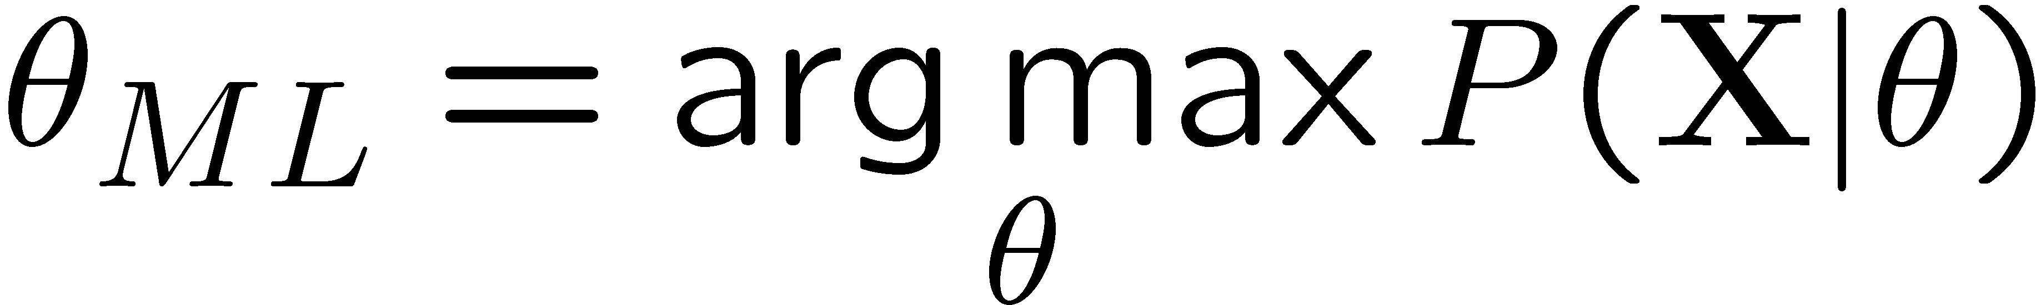
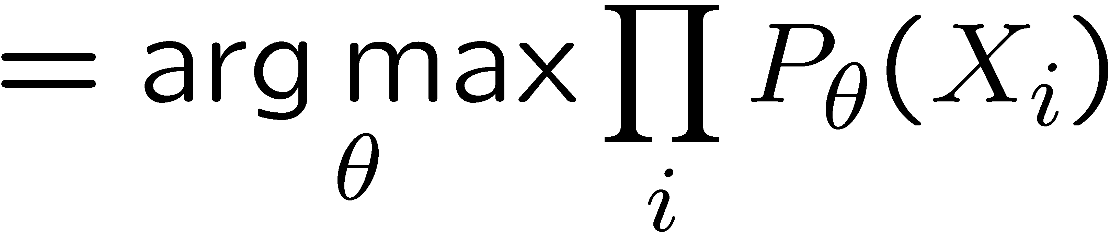
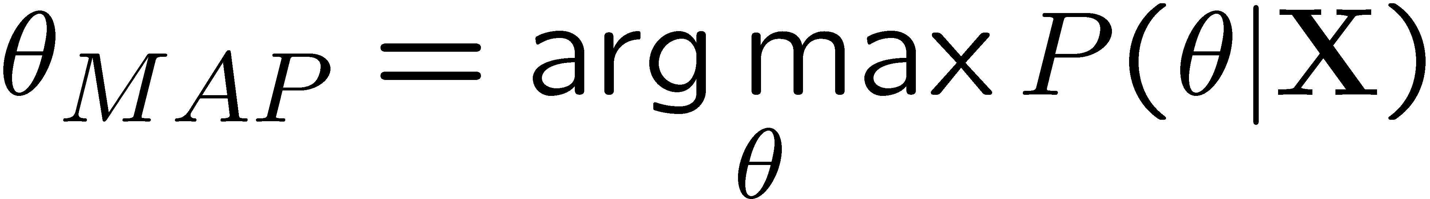
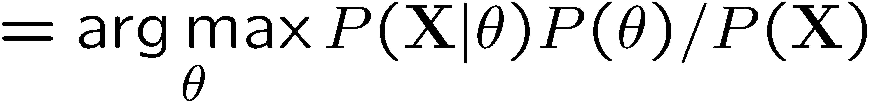
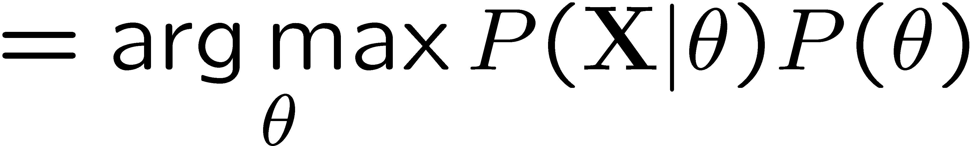
Maximum Likelihood?
Relative frequencies are the maximum likelihood estimates
Another option is to consider the most likely parameter value given the data
????

Slide 30

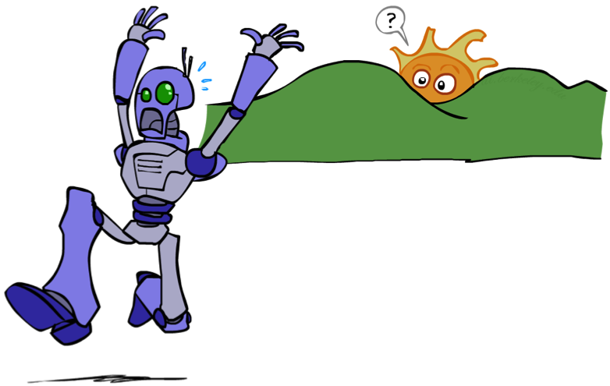
Unseen Events

Slide 31
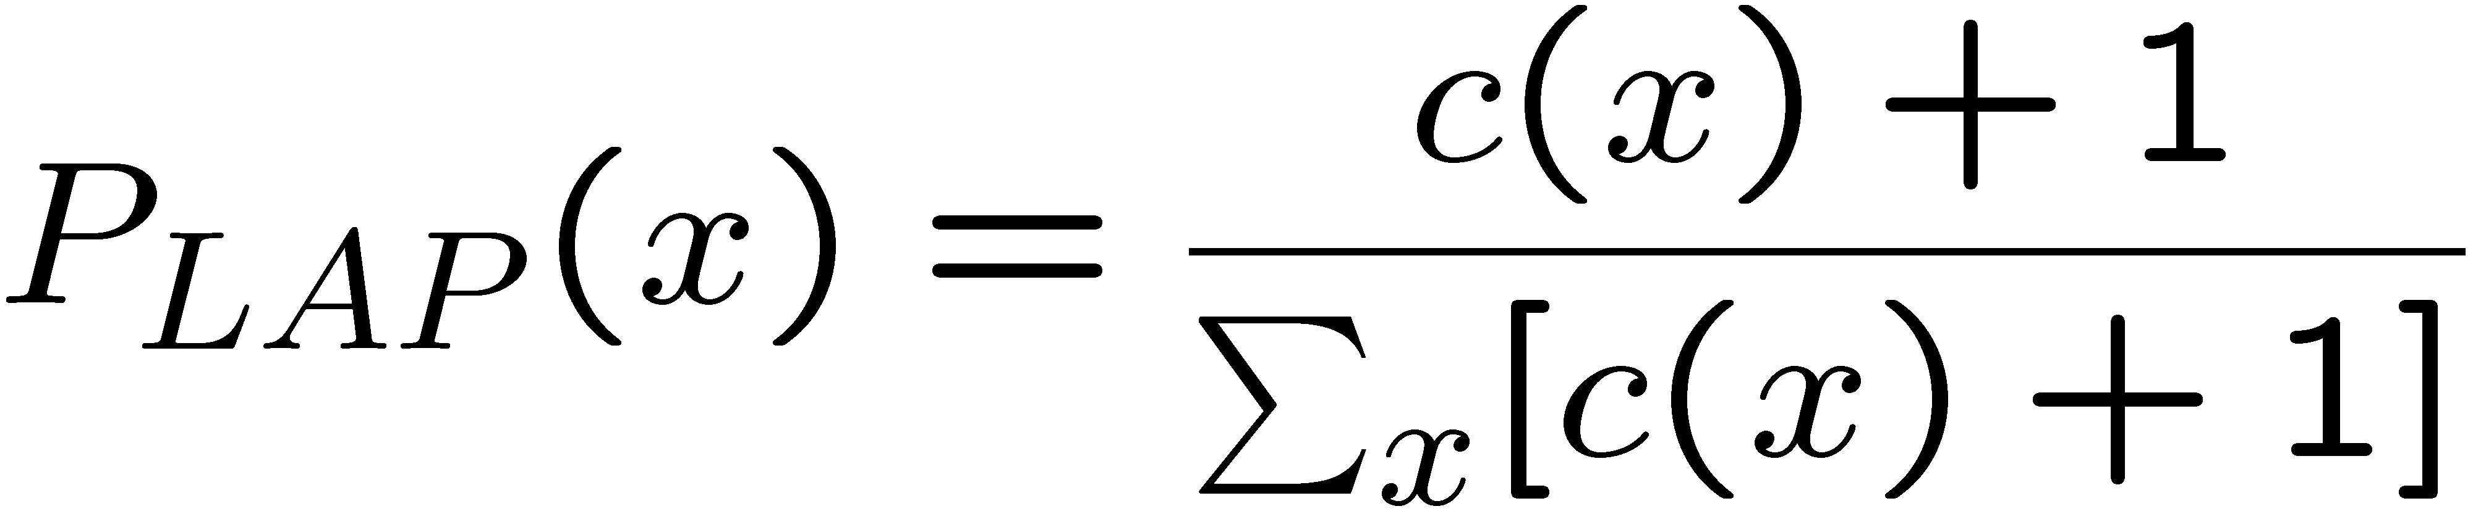
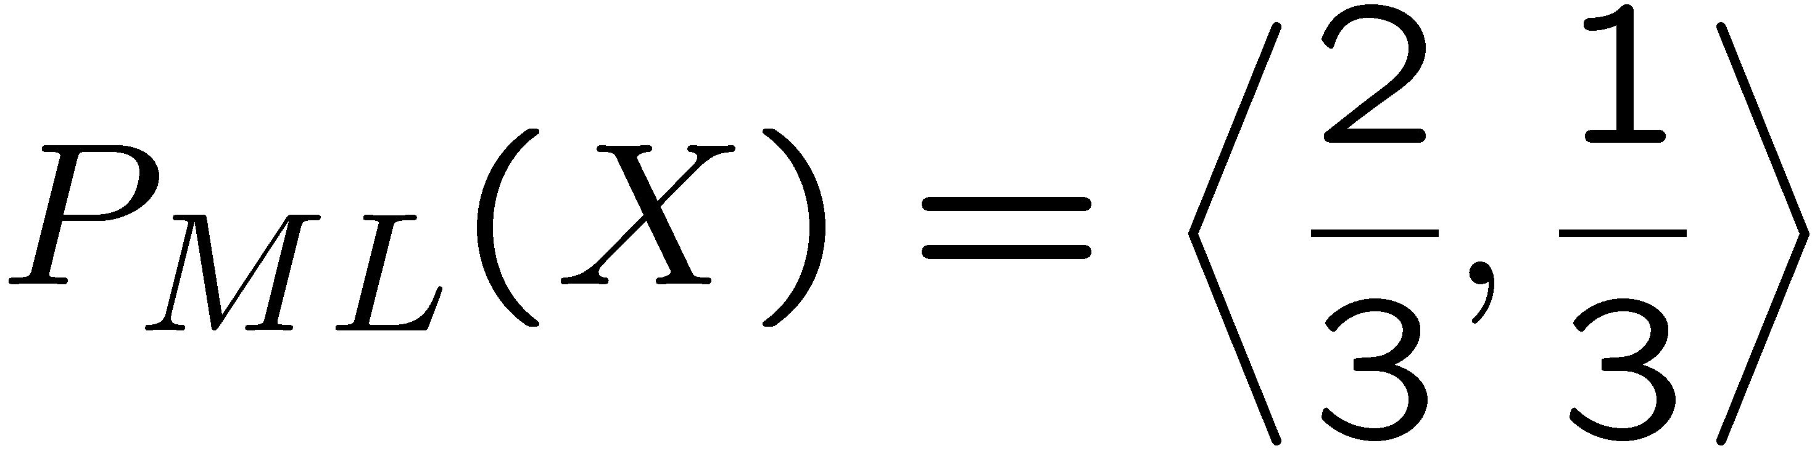
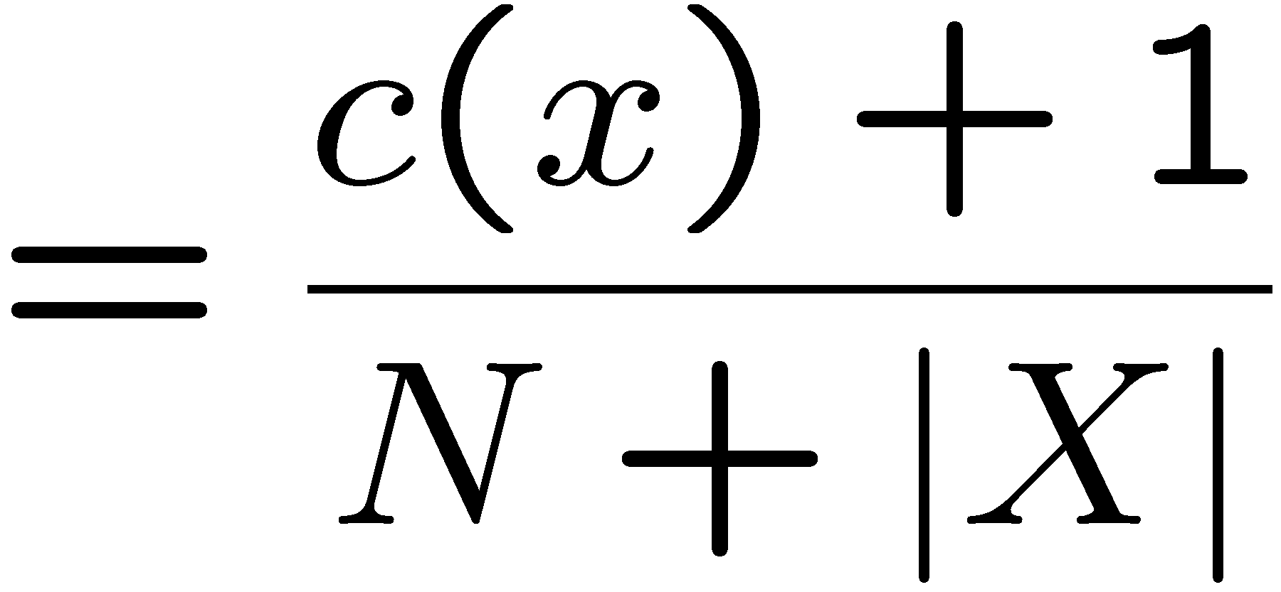
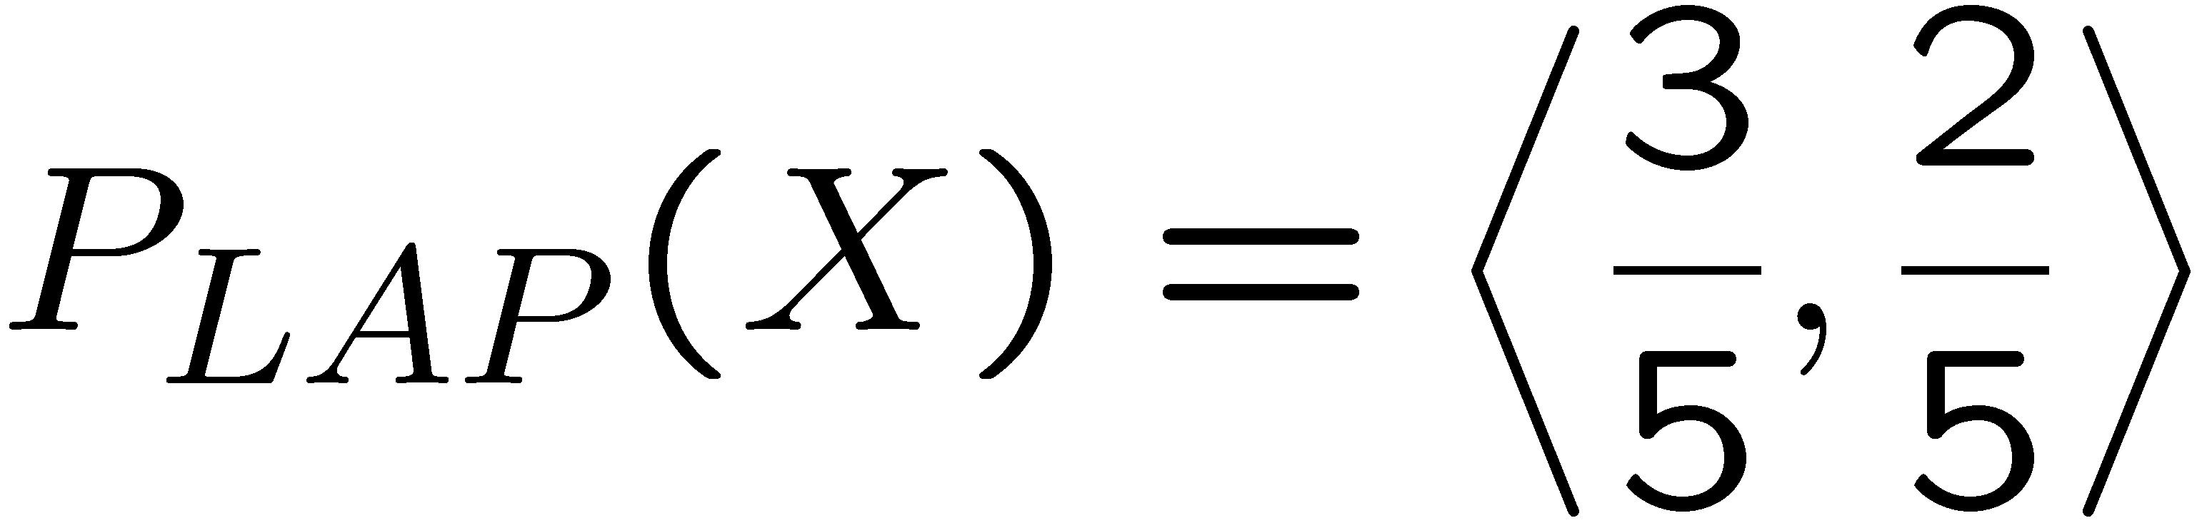
Laplace Smoothing
Laplace’s estimate:
  Pretend you saw every outcome once more than you actually did
  Can derive this estimate with Dirichlet priors (see cs281a)
r
r
b

Slide 32
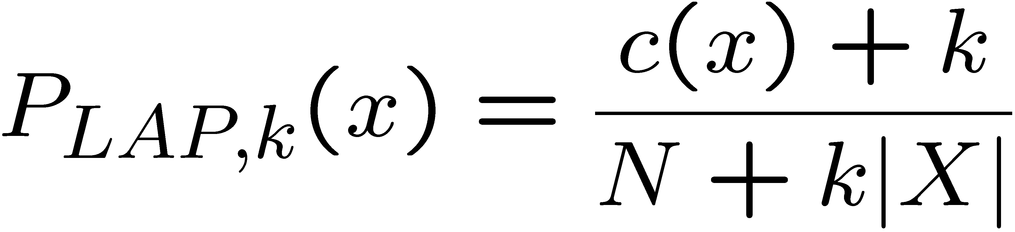
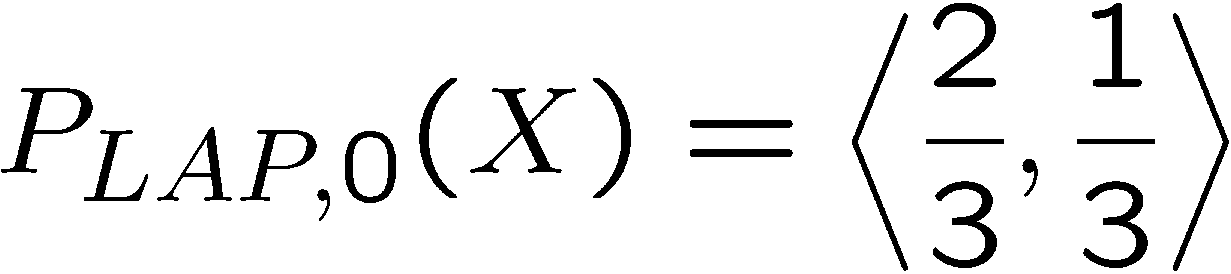
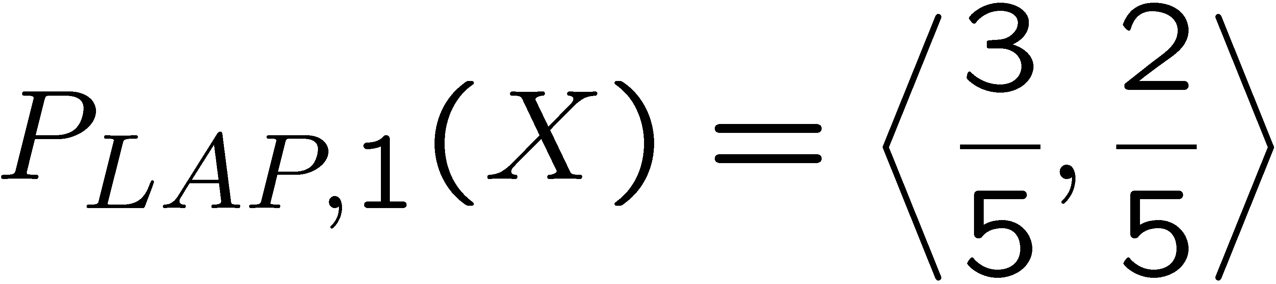
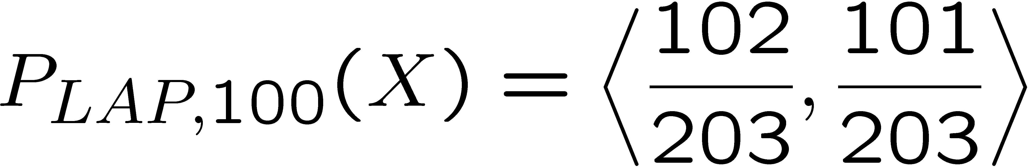
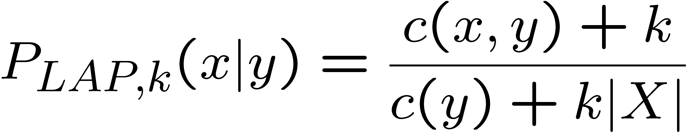
Laplace Smoothing
Laplace’s estimate (extended):
  Pretend you saw every outcome k extra times
  What’s Laplace with k = 0?
  k is the strength of the prior
Laplace for conditionals:
  Smooth each condition independently:
r
r
b

Slide 33
Estimation: Linear Interpolation*
In practice, Laplace often performs poorly for P(X|Y):
  When |X| is very large
  When |Y| is very large
Another option: linear interpolation
  Also get the empirical P(X) from the data
  Make sure the estimate of P(X|Y) isn’t too different from the empirical P(X)
  What if α is 0? 1?
For even better ways to estimate parameters, as well as details of the math, see cs281a, cs288

Slide 34
Real NB: Smoothing
For real classification problems, smoothing is critical
New odds ratios:
helvetica : 11.4
seems : 10.8
group : 10.2
ago : 8.4
areas : 8.3
...
verdana : 28.8
Credit : 28.4
ORDER : 27.2
<FONT> : 26.9
money : 26.5
...
Do these make more sense?

Slide 35
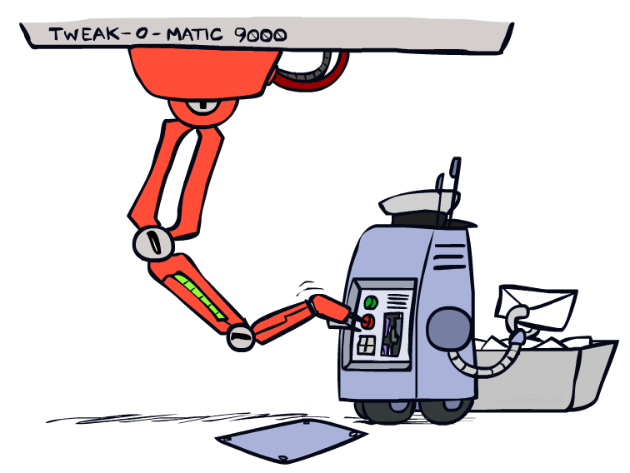
Tuning

Slide 36








Tuning on Held-Out Data
Now we’ve got two kinds of unknowns
  Parameters: the probabilities P(X|Y), P(Y)
  Hyperparameters: e.g. the amount / type of smoothing to do, k, α
What should we learn where?
  Learn parameters from training data
  Tune hyperparameters on different data
    Why?
  For each value of the hyperparameters, train and test on the held-out data
  Choose the best value and do a final test on the test data

Slide 37
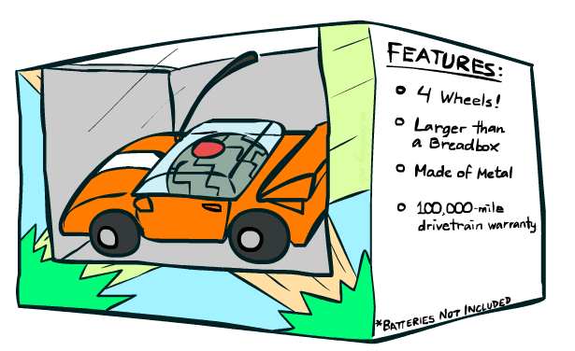
Features

Slide 38
Errors, and What to Do
Examples of errors
Dear GlobalSCAPE Customer,
GlobalSCAPE has partnered with ScanSoft to offer you the latest version of OmniPage Pro, for just $99.99* - the regular list price is $499! The most common question we've received about this offer is - Is this genuine? We would like to assure you that this offer is authorized by ScanSoft, is genuine and valid. You can get the . . .
. . . To receive your $30 Amazon.com promotional certificate, click through to
http://www.amazon.com/apparel
and see the prominent link for the $30 offer. All details are there. We hope you enjoyed receiving this message. However, if you'd rather not receive future e-mails announcing new store launches, please click . . .

Slide 39
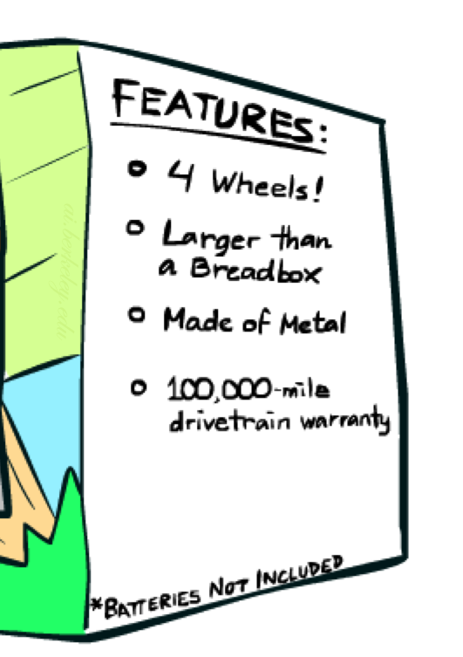
What to Do About Errors?
Need more features– words aren’t enough!
  Have you emailed the sender before?
  Have 1K other people just gotten the same email?
  Is the sending information consistent?
  Is the email in ALL CAPS?
  Do inline URLs point where they say they point?
  Does the email address you by (your) name?
Can add these information sources as new variables in the NB model
Next class we’ll talk about classifiers which let you easily add arbitrary features more easily

Slide 40
Baselines
First step: get a baseline
  Baselines are very simple “straw man” procedures
  Help determine how hard the task is
  Help know what a “good” accuracy is
Weak baseline: most frequent label classifier
  Gives all test instances whatever label was most common in the training set
  E.g. for spam filtering, might label everything as ham
  Accuracy might be very high if the problem is skewed
  E.g. calling everything “ham” gets 66%, so a classifier that gets 70% isn’t very good…
For real research, usually use previous work as a (strong) baseline

Slide 41
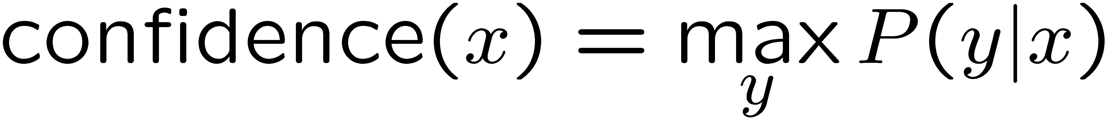

Confidences from a Classifier
The confidence of a probabilistic classifier:
  Posterior over the top label
  Represents how sure the classifier is of the classification
  Any probabilistic model will have confidences
  No guarantee confidence is correct
Calibration
  Weak calibration: higher confidences mean higher accuracy
  Strong calibration: confidence predicts accuracy rate
  What’s the value of calibration?

Slide 42
Summary
Bayes rule lets us do diagnostic queries with causal probabilities
The naïve Bayes assumption takes all features to be independent given the class label
We can build classifiers out of a naïve Bayes model using training data
Smoothing estimates is important in real systems
Classifier confidences are useful, when you can get them

Slide 43
Next Time: Perceptron!

Slide 44
Precision vs. Recall
-
Let’s say we want to classify web pages as
homepages or not
  In a test set of 1K pages, there are 3 homepages
  Our classifier says they are all non-homepages
  99.7 accuracy!
  Need new measures for rare positive events
Precision: fraction of guessed positives which were actually positive
Recall: fraction of actual positives which were guessed as positive
Say we guess 5 homepages, of which 2 were actually homepages
  Precision: 2 correct / 5 guessed = 0.4
  Recall: 2 correct / 3 true = 0.67
Which is more important in customer support email automation?
Which is more important in airport face recognition?
actual +
guessed +

Slide 45



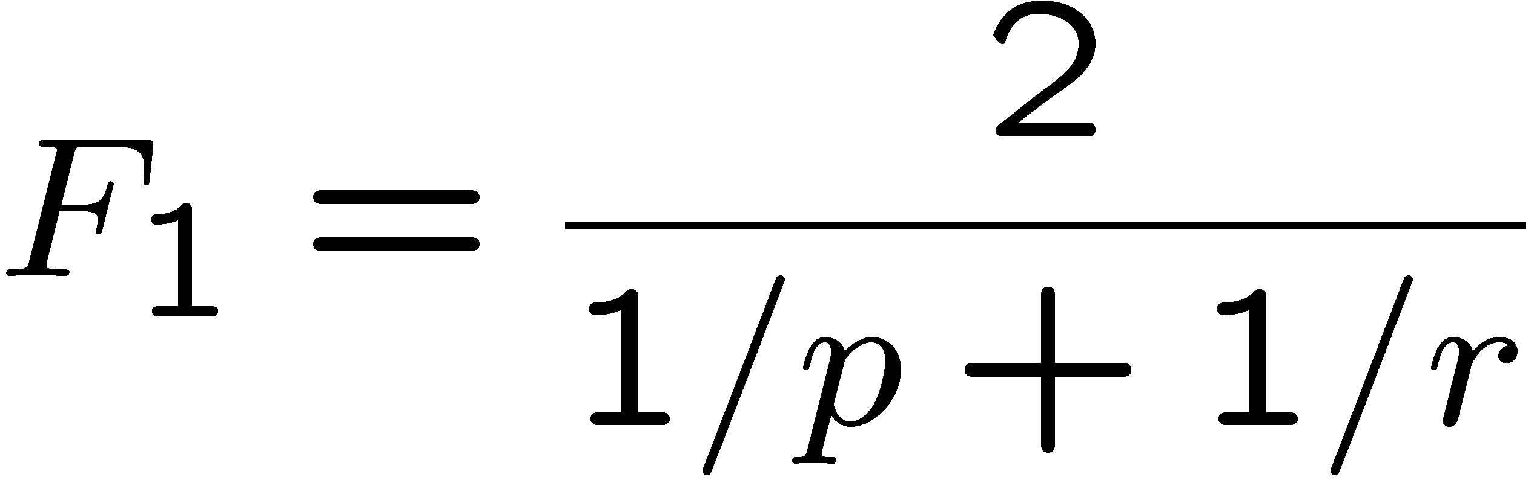
Precision vs. Recall
Precision/recall tradeoff
  Often, you can trade off precision and recall
  Only works well with weakly calibrated classifiers
To summarize the tradeoff:
  Break-even point: precision value when p = r
  F-measure: harmonic mean of p and r:

